Slide 1
Decision Procedures An Algorithmic Point of View
SAT

Slide 2
Propositional logic
A proposition – a sentence that can be either true or false.
Propositional symbols (Prop): A, B, C,…
Connectives:
∧ and
∨ or
¬ not
→ implies
↔ equivalent to
© xor (different than)
⊥, > False, True
Parenthesis:(, ).
Notes:
Example:
x is greater than y
Noam wrote this letter

Slide 3
Propositional logic: Syntax
Q1: how many different binary symbols can we define ?
Q2: what is the minimal number of such symbols?
Notes:
16 1

Slide 4
Formulas
Grammar of well-formed propositional formulas
Formula := prop | (¬Formula) | (Formula o Formula).
where prop 2 Prop and o is one of the binary relations

Slide 5
Assignments
Definition: A truth-values assignment, α, is an element of 2^{Prop} (i.e., α ∈ 2^{Prop}).
In other words, α is a subset of the variables that are assigned true.
Equivalently, we can see α as a mapping from variables to truth values: α : Prop  {0,1}
Example: α: {A  0, B  1,...}

Slide 6
Satisfaction relation ( ): intuition
An assignment can either satisfy or not satisfy a given formula.
α φ means
“α satisfies φ” or
“α is a model of φ”

Slide 7
Semantic Classification of formulas
A formula φ is called valid if models(φ) = 2^{Prop}. (also called a tautology).
A formula φ is called satisfiable if models(φ) ≠ ;.
A formula φ is called unsatisfiable if models(φ) = ;. (also called a contradiction).
satisfiable
unsatisfiable
valid

Slide 8
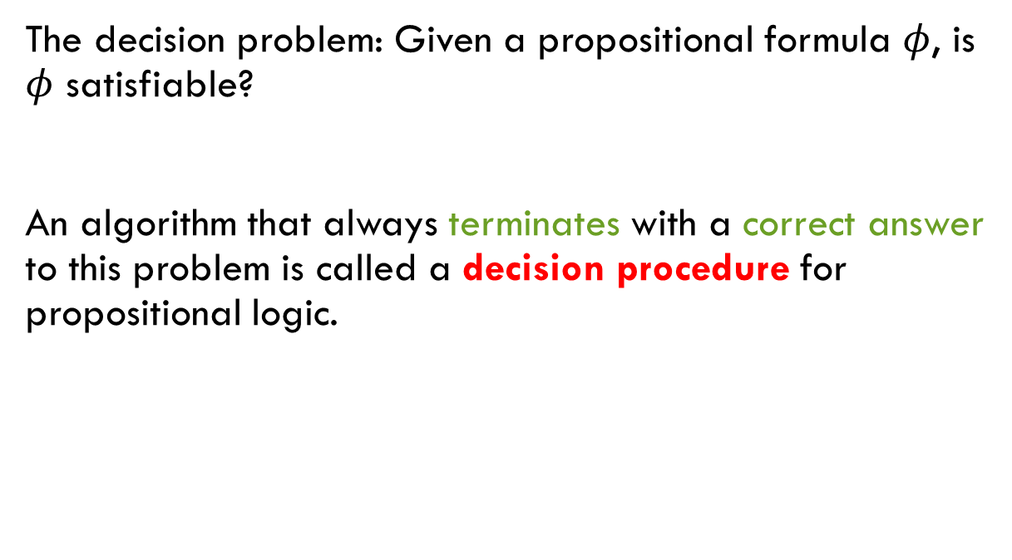
The decision problem of formulas
The decision problem: Given a propositional formula $φ$, is $φ$ satisfiable?
An algorithm that always terminates with a correct answer to this problem is called a decision procedure for propositional logic.

Slide 9
Part I Decision procedures for propositional logic
Modeling with Propositional Logic
SAT Example: Equivalence Checking if-then-else Chains
Formal Definition SAT
Conjunctive Normal Form

Slide 10
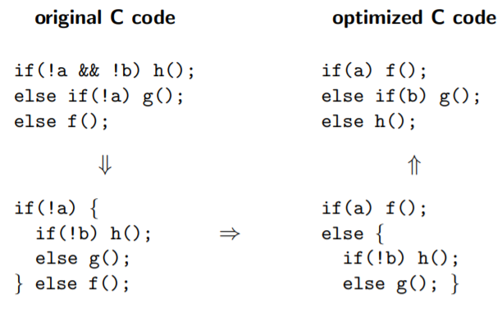
SAT Example

Slide 11
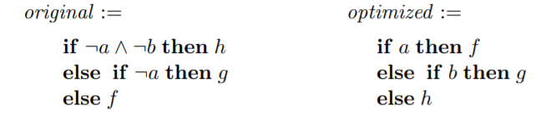
SAT Example
Represent procedures as independent Boolean variables
Compile if-then-else chains into Boolean formula
Checking equivalence of Boolean formula

Slide 12
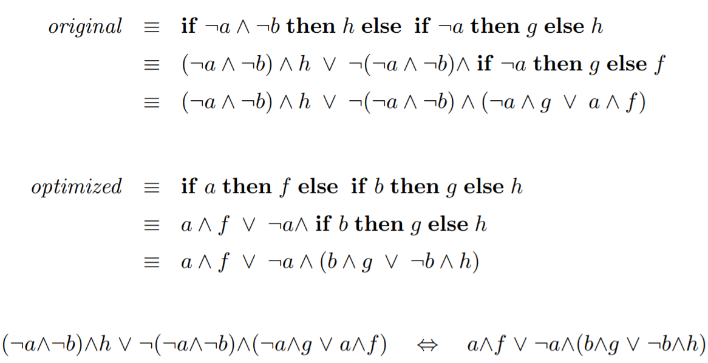
Compilation

Slide 13
How to Check (In)Equivalence
Reformulate it as a satisfiability (SAT) problem:
Is there an assignment to a, b, f, g, h, which results in different evaluations of original and optimized?

Slide 14
How to Check (In)Equivalence
Reformulate it as a satisfiability (SAT) problem:
Is there an assignment to a, b, f, g, h, which results in different evaluations of original and optimized?

Slide 15
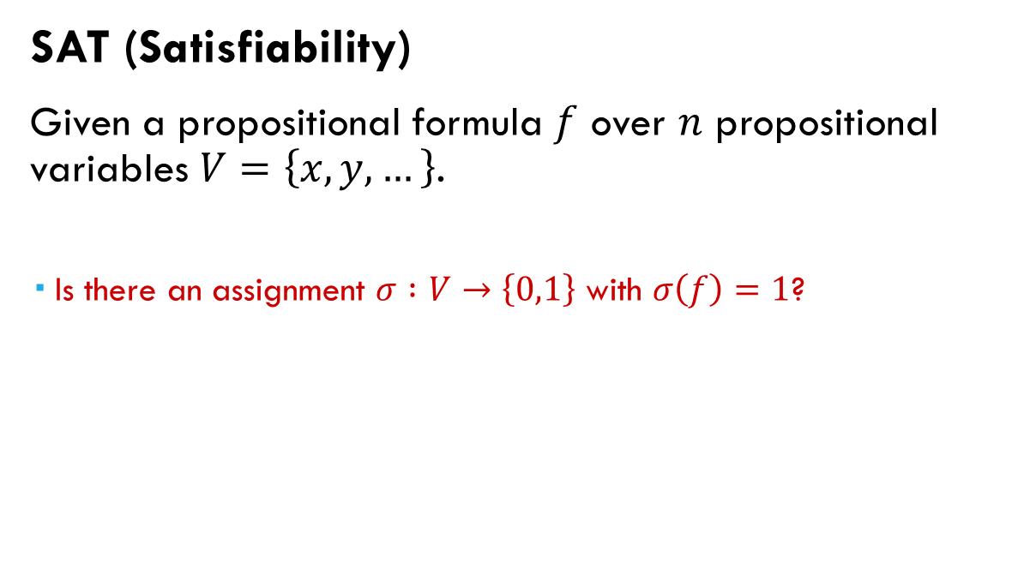
SAT
SAT (Satisfiability)
Given a propositional formula $f$ over $n$ propositional variables $V=\left\{x,y,…\right\}$.
Is there an assignment $σ :V→\left\{0,1\right\}$ with $σ\left(f\right)=1$?
Note: SAT is complete for NP, general SAT algorithms are
probably exponential in time (unless NP = P)

Slide 16
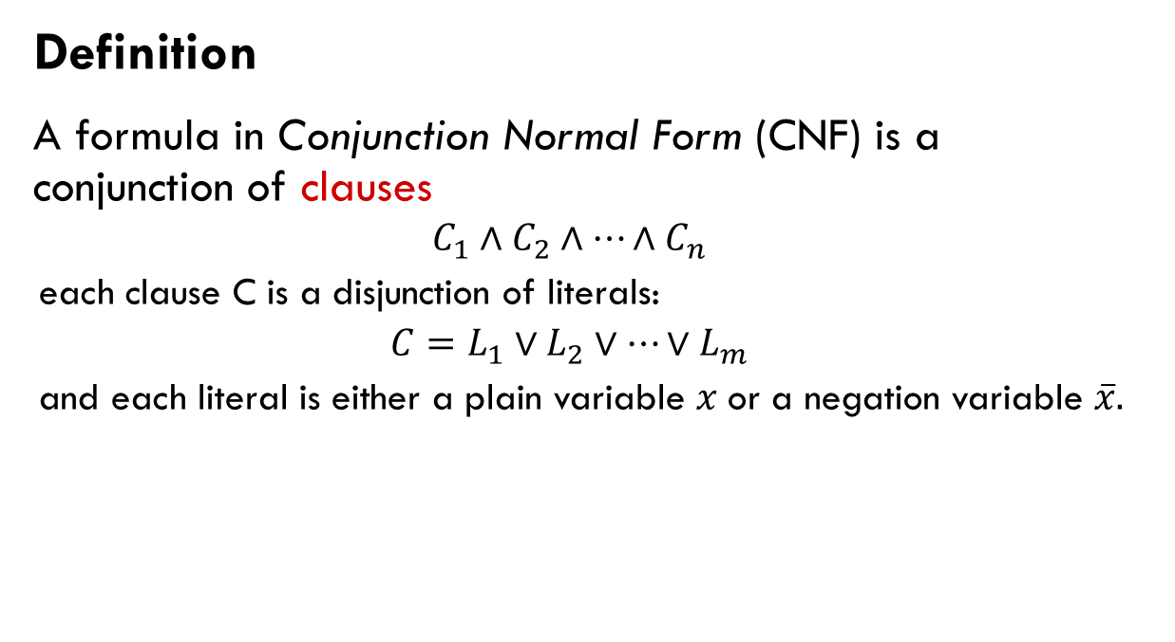
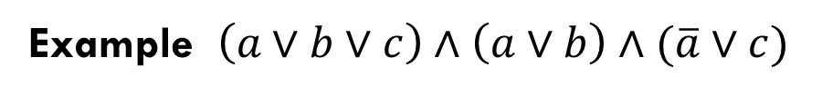
Conjunctive Normal Form
Definition
A formula in Conjunction Normal Form (CNF) is a conjunction of clauses
$$C_{1}∧C_{2}∧…∧C_{n}$$
each clause C is a disjunction of literals:
$$C=L_{1}∨L_{2}∨…∨L_{m}$$
and each literal is either a plain variable $x$or a negation variable $\overline{x}.$
Example $\left(a∨b∨c\right)∧\left(a∨b\right)∧(\overline{a}∨c)$

Slide 17
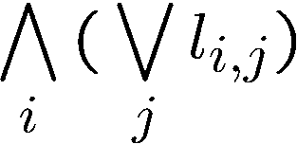
Conjunctive Normal Form
Definition
A formula in Conjunction Normal Form (CNF)：
where l_{i,j} is the j-th literal in the i-th term.
Example $\left(a∨b∨c\right)∧\left(a∨b\right)∧(\overline{a}∨c)$

Slide 18
Converting to CNF
Every formula can be converted to CNF:
In exponential time and space with the same set of variables.
In linear time and space if new variables are added.
In this case the original and converted formulas are “equi-satisfiable”.
This technique is called Tseitin’s encoding.

Slide 19
Converting to CNF: Tseitin’s encoding
!
a₁
Need to satisfy:
(a₁ $ (A ! a₂)) Æ
(a₂ $ (B Æ C)) Æ
(a₁)
Each such constraint has a CNF representation with 3 or 4 clauses.
Tseitin’s encoding is equi-satisfibility, instead of logical equivalence.
A
Æ
a₂
B
C
Notes:
可满足性等价的（同时可满足or同时不可满足），并不是逻辑等价（完全一致解）。（因为引入了新的变量）
Logical equivalence: In logic and mathematics, statements p and q are said to be logically equivalent if they are provable from each other under a set of axioms, or have the same truth value in every model. Equisatisfibility: In logic, two formulae are equisatisfiable if the first formula is satisfiable whenever the second is and vice versa; in other words, either both formulae are satisfiable or both are not.

Slide 20
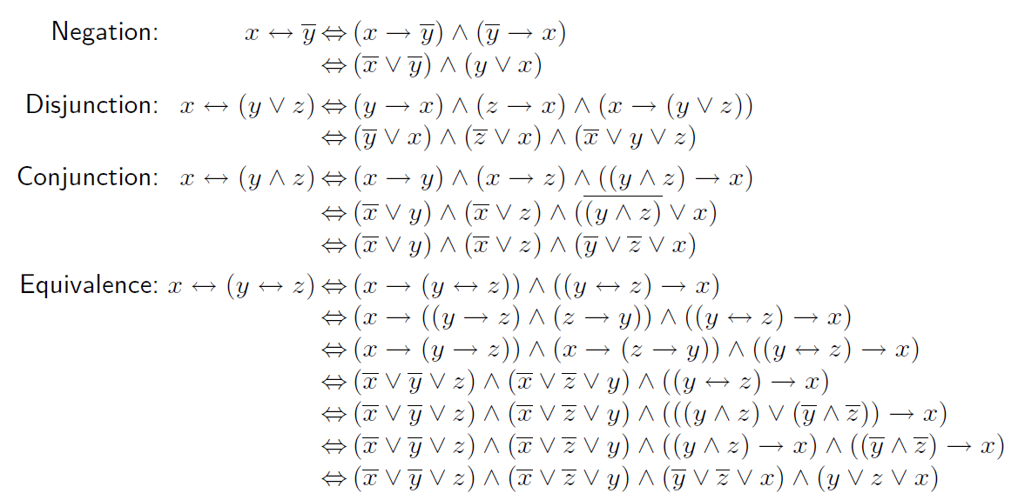
Converting to CNF: Tseitin’s encoding

Slide 21
Converting to CNF: Tseitin’s encoding
Need to satisfy:
(a₁ $ (A ! a₂)) Æ
(a₂ $ (B Æ C)) Æ
(a₁)
First: (a₁ Ç A) Æ (a₁ Ç :a₂) Æ (:a₁ Ç :A Ç a₂)
Second: (:a₂ Ç B) Æ (:a₂ Ç C) Æ (a₂ Ç :B Ç :C)

Slide 22
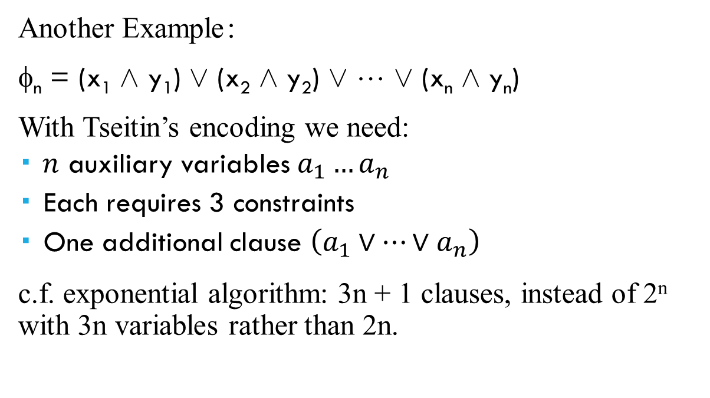
Converting to CNF: Tseitin’s encoding
Another Example：
φ_{n} = (x₁ Æ y₁) Ç (x₂ Æ y₂) Ç ☹ Ç (x_{n} Æ y_{n})
With Tseitin’s encoding we need:
$n$ auxiliary variables $a_{1}…a_{n}$
Each requires 3 constraints
One additional clause $\left(a_{1}∨⋯∨a_{n}\right)$
c.f. exponential algorithm: 3n + 1 clauses, instead of 2^{n} with 3n variables rather than 2n.
Notes:
3n variables = 2n origins + n aux variables

Slide 23
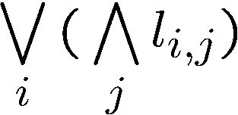
Disjunctive Normal Form (DNF)
Definition: A formula is said to be in Disjunctive Normal Form (DNF) if it is a disjunction of terms.
where l_{i,j} is the j-th literal in the i-th term.
Examples
φ = (A Æ :B Æ C) Ç (:A Æ D) Ç (B) is in DNF
DNF is a special case of NNF

Slide 24
Converting to DNF
Every formula can be converted to DNF in exponential time and space:
Convert to NNF
Distribute disjunctions following the rule: A Æ (B Ç C) $ ((A Æ B) Ç (A Æ C))
Example:
φ = (A Ç B) Æ (:C Ç D) = ((A Ç B) Æ (:C)) Ç ((A Ç B) Æ D) = (A Æ :C) Ç (B Æ :C) Ç (A Æ D) Ç (B Æ D)

Slide 25
Negation Normal Form (NNF)
Definition: A formula is said to be in Negation Normal Form (NNF) if it only contains :, Æ and Ç connectives and only atoms can be negated.
Examples:
φ₁ = :(A Ç :B) is not in NNF
φ₂ = :A Æ B is in NNF
CNF is a special case of NNF

Slide 26
Converting to NNF
Every formula can be converted to NNF in linear time:
Eliminate all connectives other than Æ, Ç, :
Use De Morgan and double-negation rules to push negations to the right
Example: φ = :(A ! :B)
Eliminate ‘!’: φ = :(:A Ç :B)
Push negation using De Morgan: φ = (::A Æ ::B)
Use Double negation rule: φ = (A Æ B)

Slide 27
Two classes of algorithms for validity
Q: Is φ valid ?
Equivalently: is :φ satisfiable?
Two classes of algorithm for finding out:
Enumeration of possible solutions (Truth tables etc).
Deduction
In general (beyond propositional logic):
Enumeration is possible only in some theories.
Deduction typically cannot be fully automated.

Slide 28
The satisfiability Problem: enumeration
Given a formula φ, is φ satisfiable?
Boolean SAT(φ) {
B:=false
for all α ∈ 2^{AP(φ)}
B = B ∨ Eval(φ,α)
end
return B
}
NP-Complete (root question)

Slide 29
The satisfiability Problem: deduction
Inference rules: Antecedents Consequent
Examples:
A ! B B ! C A ! C
A ! B A B
(rule-name)
(trans)
(M.P.)

Slide 30
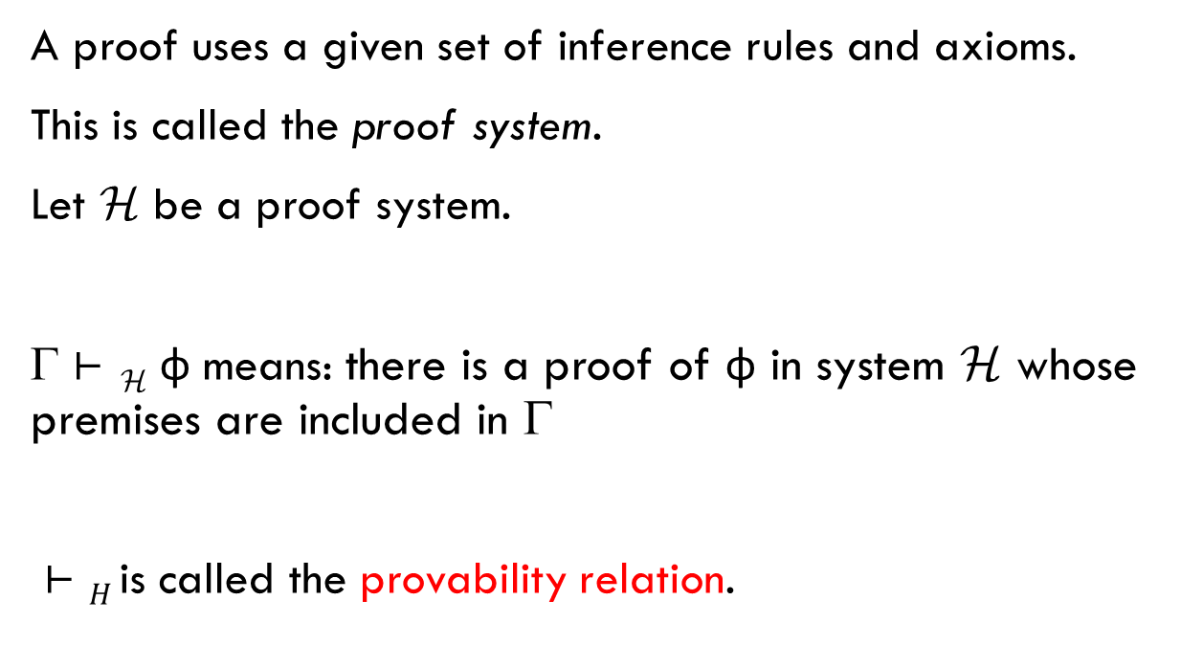
Proofs
A proof uses a given set of inference rules and axioms.
This is called the proof system.
Let H be a proof system.
Γ $⊢$ `_{H} φ means: there is a proof of φ in system H whose premises are included in Γ
`$⊢H$is called the provability relation.

Slide 31
Example: Hilbert axiom system (H)
Let H be (M.P) + the following axiom schemas:
(H1)
A ! (B ! A)
(H2)
((A !(B ! C)) !((A! B)!(A! C))
(H3)
(:B ! :A) ! (A ! B)
H is sound and complete

Slide 32
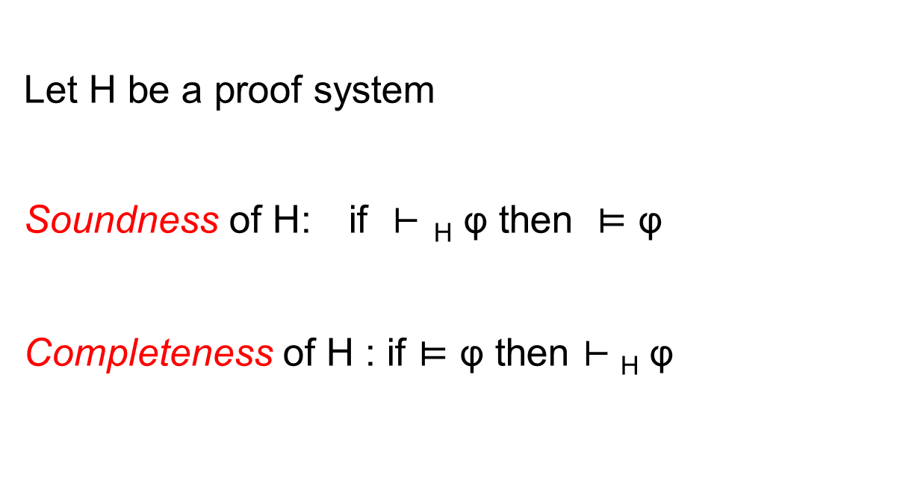
Soundness and completeness
Let H be a proof system
Soundness of H: if ` $⊢$ _{H} φ then $⊨$ φ
Completeness of H : if $⊨$ φ then $⊢$_{H} φ

Slide 33
Part II Deciding Propositional Logic
SAT tools
Binary Decision Diagrams

Slide 34
SAT made some progress…

Slide 35
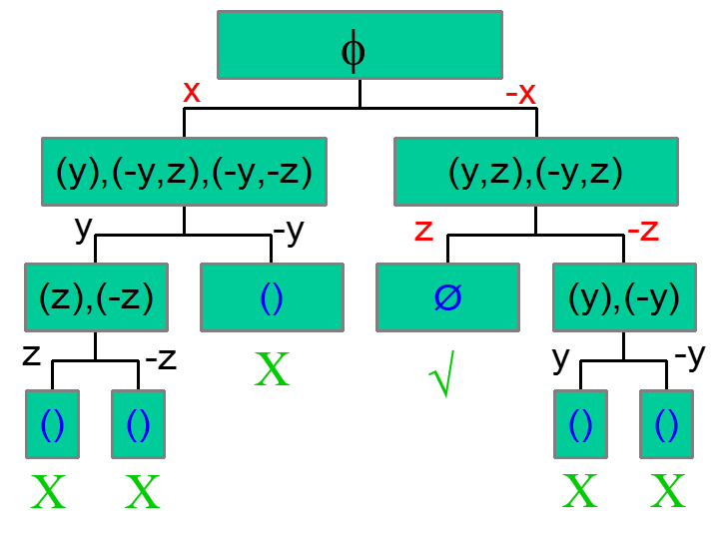
A Basic SAT algorithm
Given φ in CNF: (x,y,z),(-x,y),(-y,z),(-x,-y,-z)
Decide()
BCP()
Resolve_Conflict()

Slide 36
A Basic SAT algorithm
Choose the next
variable and value.
Return False if all
variables are assigned
While (true)
{
if (!Decide()) return (SAT);
while (!BCP())
if (!Resolve_Conflict()) return (UNSAT);
}
Apply repeatedly the unit clause rule.
Return False if reached
a conflict
Backtrack until
no conflict.
Return False if impossible

Slide 37
Basic Backtracking Search
Organize the search in the form of a decision tree
Each node corresponds to a decision
Definition: Decision Level (DL) is the depth of the node in the decision tree.
Notation: x=v@d x 2 {0,1} is assigned to v at decision level d

Slide 38
Backtracking Search in Action
ω₁ = (x₂ ∨ x₃)
ω₂ = (¬x₁ ∨ ¬x₄)
ω₃ = (¬x₂ ∨ x₄)
x₁
x₁ = 0@1
x₂
x₁ = 1@1
⇒ x₄ = 0@1
⇒ x₂ = 0@1
x₂ = 0@2
⇒ x₃ = 1@1
⇒ x₃ = 1@2
{x₁  1, x₂  0, x₃  1, x₄  0}
{x₁  0, x₂  0, x₃  1}
No backtrack in this example, regardless of the decision!
Notes:
Say which step is which.

Slide 39
Backtracking Search in Action
Add a clause
ω₁ = (x₂ ∨ x₃)
ω₂ = (¬x₁ ∨ ¬x₄)
ω₃ = (¬x₂ ∨ x₄)
ω₄ = (¬x₁ ∨ x₂ ∨ ¬x₃)
x₁
x₁ = 0@1
x₁ = 1@1
⇒ x₄ = 0@1
x₂
⇒ x₂ = 0@1
⇒ x₃ = 1@1
conflict
x₂ = 0@2
⇒ x₃ = 1@2
{x₁ 0, x₂  0, x₃  1}

Slide 40
Status of a clause
A clause can be
Satisfied: at least one literal is satisfied
Unsatisfied: all literals are assigned but none are satisfied
Unit: all but one literals are assigned but none are satisfied
Unresolved: all other cases
Example: C = (x₁ Ç x₂ Ç x₃)
x₁ | x₂ | x₃ | C
1 | 0 |  | Satisfied
0 | 0 | 0 | Unsatisfied
0 | 0 |  | Unit
 | 0 |  | Unresolved

Slide 41
DLIS (Dynamic Largest Individual Sum) – choose the assignment that increases the most the number of satisfied clauses
Decision heuristics - DLIS
For a given variable x:
C_{xp} – # unresolved clauses in which x appears positively
C_{xn} - # unresolved clauses in which x appears negatively
Let x be the variable for which C_{xp} is maximal
Let y be the variable for which C_{yn} is maximal
If C_{xp} > C_{yn} choose x and assign it TRUE
Otherwise choose y and assign it FALSE
Requires l (#literals) queries for each decision.

Slide 42
Decision heuristics - JW
Jeroslow-Wang method
Compute for every clause ω and every variable l (in each phase):
J(l) :=
Choose a variable l that maximizes J(l).
This gives an exponentially higher weight to literals in shorter clauses.

Slide 43
Pause II ...
We will see other (more advanced) decision Heuristics soon.
These heuristics are integrated with a mechanism called Learning with Conflict-Clauses, which we will learn next.

Slide 44
Implication graphs and learning: option #1
Past truth assignment: {x₉=0@1 ,x₁₀=0@3, x₁₁=0@3, x₁₂=1@2, x₁₃=1@2}
Current truth assignment: {x₁=1@6}
x₁₀=0@3
ω₁ = (¬x₁ ∨ x₂)
ω₂ = (¬x₁ ∨ x₃ ∨ x₉)
ω₃ = (¬x₂ ∨ ¬x₃ ∨ x₄)
ω₄ = (¬x₄ ∨ x₅ ∨ x₁₀)
ω₅ = (¬x₄ ∨ x₆ ∨ x₁₁)
ω₆ = (¬x₅ ∨ ¬ x₆)
ω₇ = (x₁ ∨ x₇ ∨ ¬x₁₂)
ω₈ = (x₁∨ x₈)
ω₉ = (¬x₇ ∨ ¬x₈ ∨ ¬ x₁₃)
x₂=1@6
ω₄
x₅=1@6
ω₁
ω₄
ω₃
ω₆
x₁=1@6
x₄=1@6
ω₆
κ
conflict
ω₃
ω₂
ω₅
ω₂
ω₅
x₆=1@6
x₃=1@6
x₉=0@1
x₁₁=0@3
We learn the conflict clause ω₁₀ : (: x₁ Ç x₉ Ç x₁₁ Ç x₁₀)

Slide 45
Implication graph, flipped assignment option #1
x₁₃=1@2
ω₁ = (¬x₁ ∨ x₂)
ω₂ = (¬x₁ ∨ x₃ ∨ x₉)
ω₃ = (¬x₂ ∨ ¬x₃ ∨ x₄)
ω₄ = (¬x₄ ∨ x₅ ∨ x₁₀)
ω₅ = (¬x₄ ∨ x₆ ∨ x₁₁)
ω₆ = (¬x₅ ∨ x₆)
ω₇ = (x₁ ∨ x₇ ∨ ¬x₁₂)
ω₈ = (x₁∨ x₈)
ω₉ = (¬x₇ ∨ ¬x₈ ∨ ¬ x₁₃)
ω₁₀ : (: x₁ Ç x₉ Ç x₁₁ Ç x₁₀)
x₉=0@1
x₈=1@6
ω₉
ω₁₀
ω₈
x₁₀=0@3
ω₉
x₁=0@6
κ’
ω₁₀
ω₉
ω₁₀
ω₇
x₁₁=0@3
ω₇
x₇=1@6
Due to the conflict clause
x₁₂=1@2
No decision here
Another conflict clause:ω₁₁: (:x₁₃ Ç :x₁₂ Ç x₁₁ Ç x₁₀ Ç x₉)
where should we backtrack to now ?

Slide 46
Non-chronological backtracking
3
Decision level
Which assignments caused
the conflicts ?
x₉= 0@1
x₁₀= 0@3
x₁₁= 0@3
x₁₂= 1@2
x₁₃= 1@2
Backtrack to DL = 3
4
5
These assignments
Are sufficient for
Causing a conflict.
x₁
6
κ
κ’
Non-chronological
backtracking

Slide 47
Non-chronological backtracking
So the rule is: backtrack to the largest decision level in the conflict clause.
This works for both the initial conflict and the conflict after the flip.
Q: What if the flipped assignment works? A: Change the decision retroactively.

Slide 48
Non-chronological Backtracking
x₁ = 0
x₂ = 0
x₃ = 1
x₃ = 0
x₄ = 0
x₆ = 0
x₅ = 0
x₅ = 1
...
x₇ = 1
x₉ = 0
x₉ = 1
Notes:
Here without implications

Slide 49
More Conflict Clauses
Def: A Conflict Clause is any clause implied by the formula
Let L be a set of literals labeling nodes that form a cut in the implication graph, separating the conflict node from the roots.
Claim: Ç_{l2L}:l is a Conflict Clause.
x₁₀=0@3
2
1. (x₁₀ Ç :x₁ Ç x₉ Ç x₁₁)
1
x₂=1@6
ω₄
x₅=1@6
2. (x₁₀ Ç :x₄ Ç x₁₁)
ω₁
ω₄
ω₃
ω₆
x₁=1@6
x₄=1@6
ω₆
κ
conflict
3. (x₁₀ Ç :x₂ Ç :x₃ Ç x₁₁)
ω₃
ω₂
ω₅
ω₂
ω₅


x₃=1@6
x₆=1@6
x₉=0@1
x₁₁=0@3
3

Slide 50
Conflict clauses
How many clauses should we add ?
If not all, then which ones ?
Shorter ones ?
Check their influence on the backtracking level ?
The most “influential” ?

Slide 51
Conflict clauses
Def: An Asserting Clause is a Conflict Clause with a single literal from the current decision level. Backtracking (to the right level) makes it a Unit clause.
Asserting clauses are those that force an immediate change in the search path.
Modern solvers only consider Asserting Clauses.

Slide 52
Unique Implication Points (UIP’s)
Definition: A Unique Implication Point (UIP) is an internal node in the Implication Graph that all paths from the current decision to the conflict node go through it.
The First-UIP is the closest UIP to the conflict.
ω₄
ω₁
UIP
ω₄
UIP
ω₃
ω₆
ω₆
κ
conflict
ω₃
ω₂
ω₅
ω₂
ω₅

Slide 53
Conflict-driven backtracking (option #2)
Conflict clause: (x₁₀ Ç :x₄ Ç x₁₁)
With standard Non-Chronological Backtracking we backtracked to DL = 6.
Conflict-driven Backtrack: backtrack to the second highest decision level in the clause (without erasing it).
In this case, to DL = 3.
Q: why?
x₁₀=0@3
κ
conflict
x₄=1@6
x₁₁=0@3
Notes:
Answers: already in decision level 3 x4=0 is implied.
Why is it better ? because the new clause changes the decision heuristic’s decision. So we want to give it a fresh start from DL = 3, and not get stuck with decisions and implications that were made before we had the knowledge on the conflict.

Slide 54
Conflict-driven Non-chronological Backtracking
x₁ = 0
x₂ = 0
x₃ = 1
x₅ = 1
x₄ = 0
x₇ = 1
x₅ = 0
x₃ = 1
x₉ = 1
x₉ = 0
x₆ = 0
...

Slide 55
Progress of a SAT solver
work invested in refuting x=1
(some of it seems wasted)
C
x=1
Refutation of x=1
C₅
C₂
Decision
Level
C₁
C₄
BCP
C₃
Decision
Time
Conflict

Slide 56
Conflict-Driven Backtracking
So the rule is: backtrack to the second highest decision level dl, but do not erase it.
This way the literal with the currently highest decision level will be implied in DL = dl.
Q: what if the conflict clause has a single literal ?
For example, from (xÇ :y) Æ (x Ç y) and decision x=0, we learn the conflict clause (x).
Notes:
Answer: we jump to level 0. This is clear, because \neg x is not a consequence of any other decision.

Slide 57
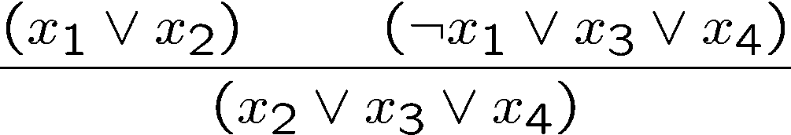
Conflict clauses and Resolution
The Binary-resolution is a sound inference rule:
Example:

Slide 58
Conflict clauses and resolution
Consider the following example:
Conflict clause: c₅: (x₂ Ç :x₄ Ç x₁₀)

Slide 59
Conflict clauses and resolution
Conflict clause: c₅: (x₂ Ç :x₄ Ç x₁₀)
Resolution order: x₄,x₅,x₆,x₇ in reverse
T1 = Res(c₄,c₃,x₇) = (:x₅ Ç :x₆)
T2 = Res(T1, c₂, x₆) = (:x₄ Ç :x₅ Ç X₁₀ )
T3 = Res(T2,c₁,x₅) = (x₂ Ç :x₄ Ç x₁₀ )

Slide 60
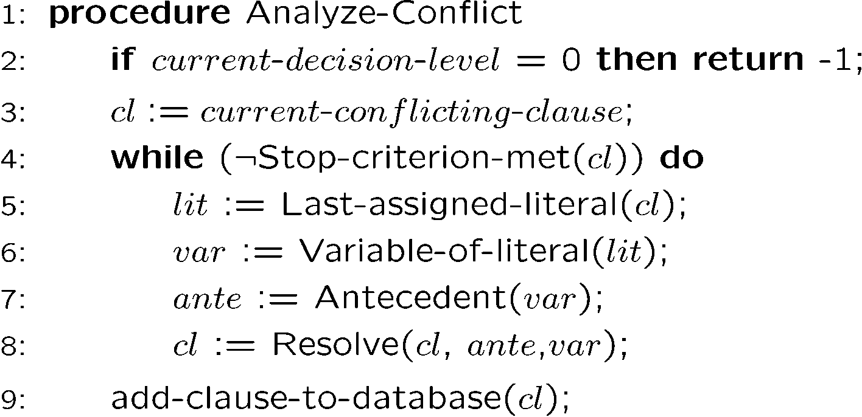
Finding the conflict clause:
cl is asserting the first UIP
Applied to our example:

Slide 61
The Resolution-Graph keeps track of the “inference relation”
Resolution Graph
ω₁
ω₄
ω₁
ω₄
ω₂
ω₃
ω₆
ω₆
κ
conflict
ω₃
ω₂
ω₅
ω₃
ω₂
ω₅
ω₁₀
ω₄
ω₁₁
ω₉
ω₅
ω₁₀
ω₈
ω₇
ω₉
κ’
conflict
ω₆
ω₈
ω₁₀
ω₉
ω₁₀
ω₇
ω₉
ω₇

Slide 62
The resolution graph
What is it good for ?
Example: for computing an Unsatisfiable core
[Picture Borrowed from Zhang, Malik SAT’03]

Slide 63
Resolution graph: example
Empty clause
learning
Inferred
clauses
L :
Original clauses
Unsatisfiable core

Slide 64
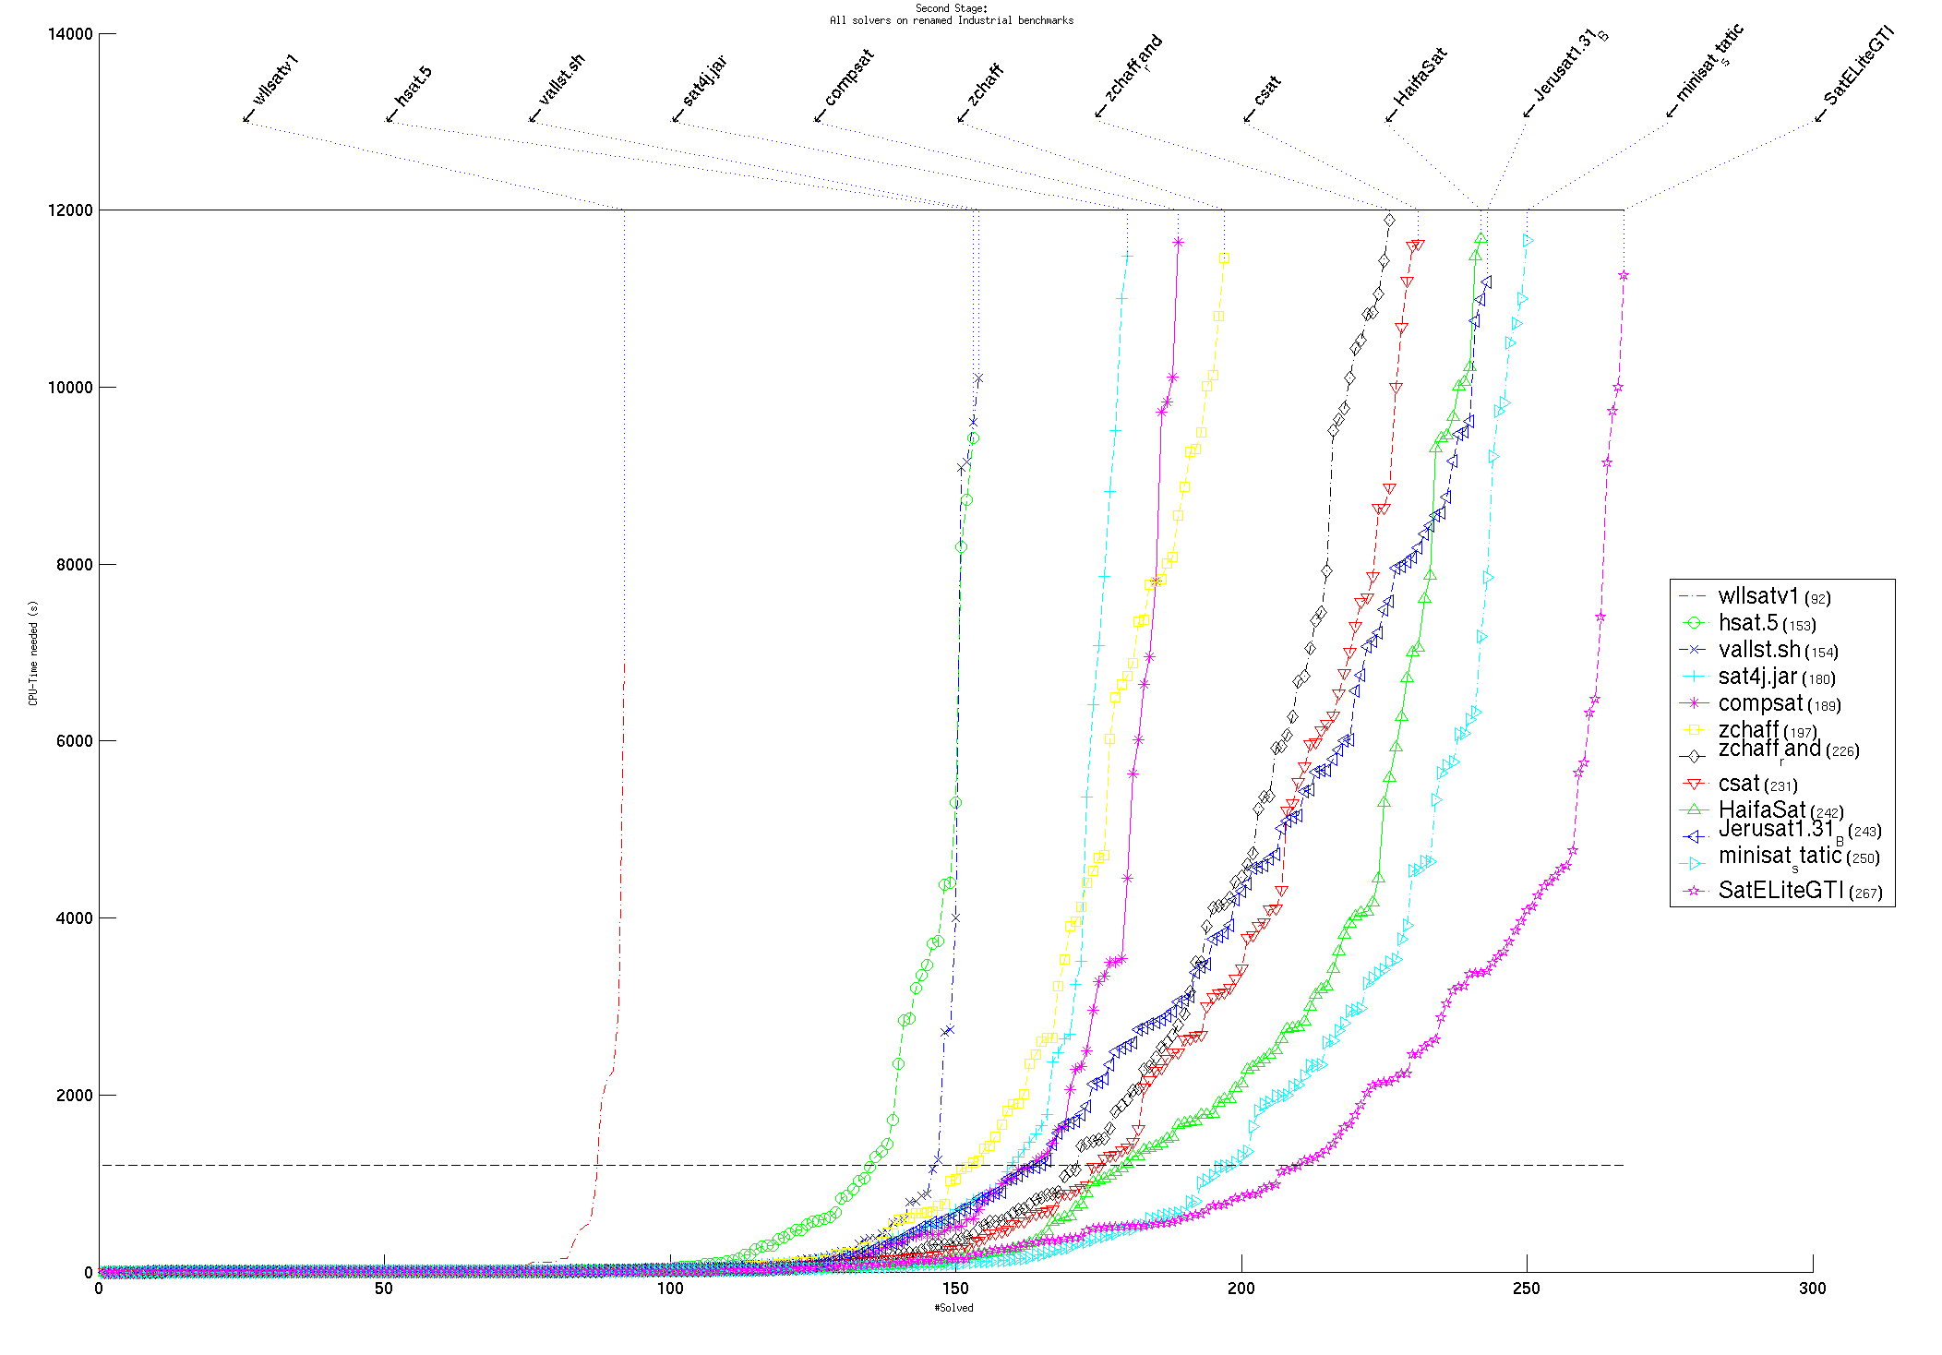
The SAT competitions

Slide 65
End of SAT (for now)
Beginning of Binary Decision Diagrams

Slide 66
Part III Applications of SAT

